Slide 1
Swift Day 13

Slide 2
Summary
Map Kit Introductions
Core Location framework
Google Map SDK

Slide 3
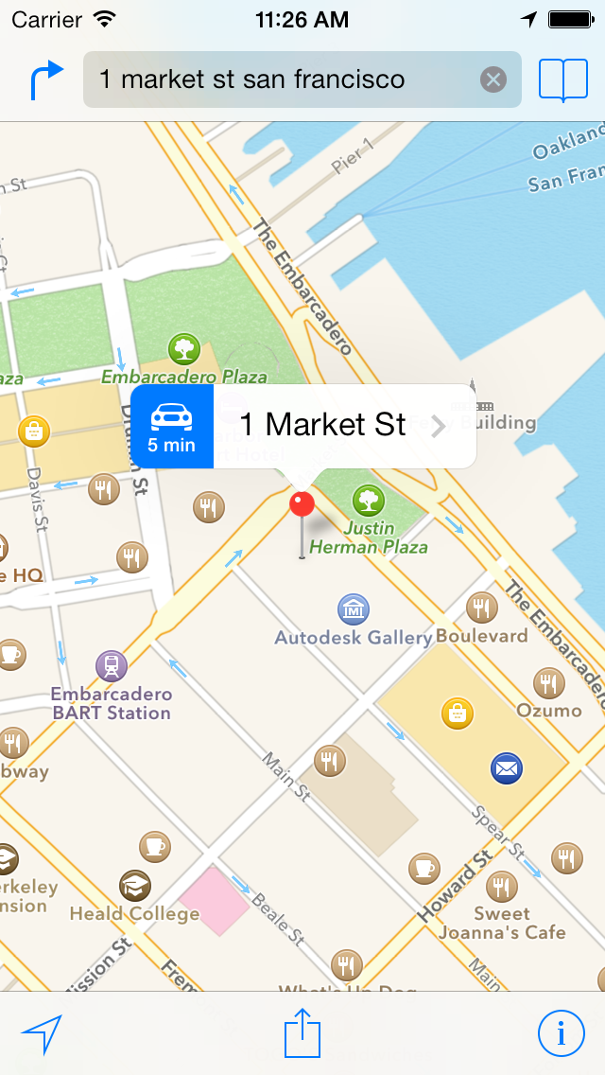

Map Kit Introductions
Need a map for your app.?

Slide 4
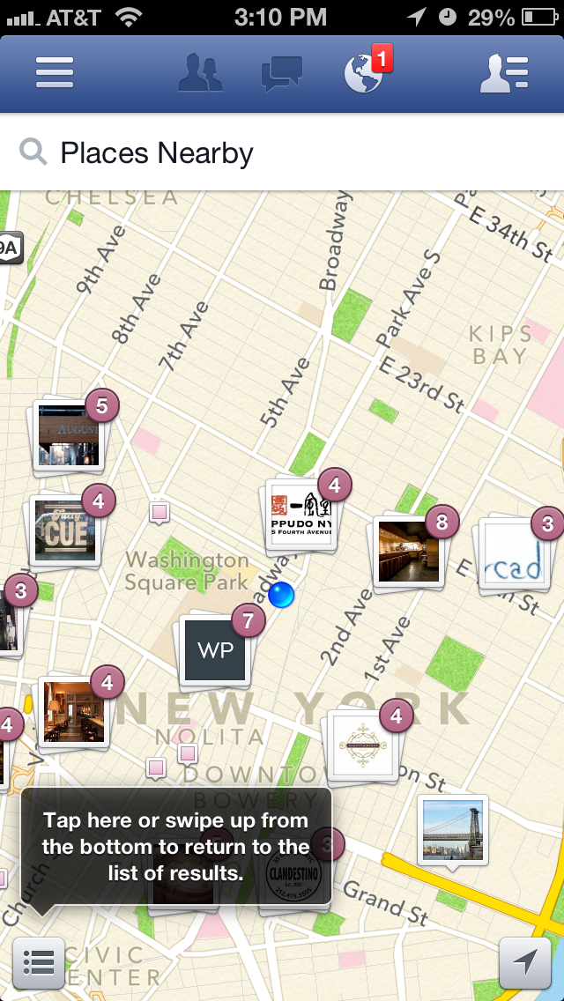
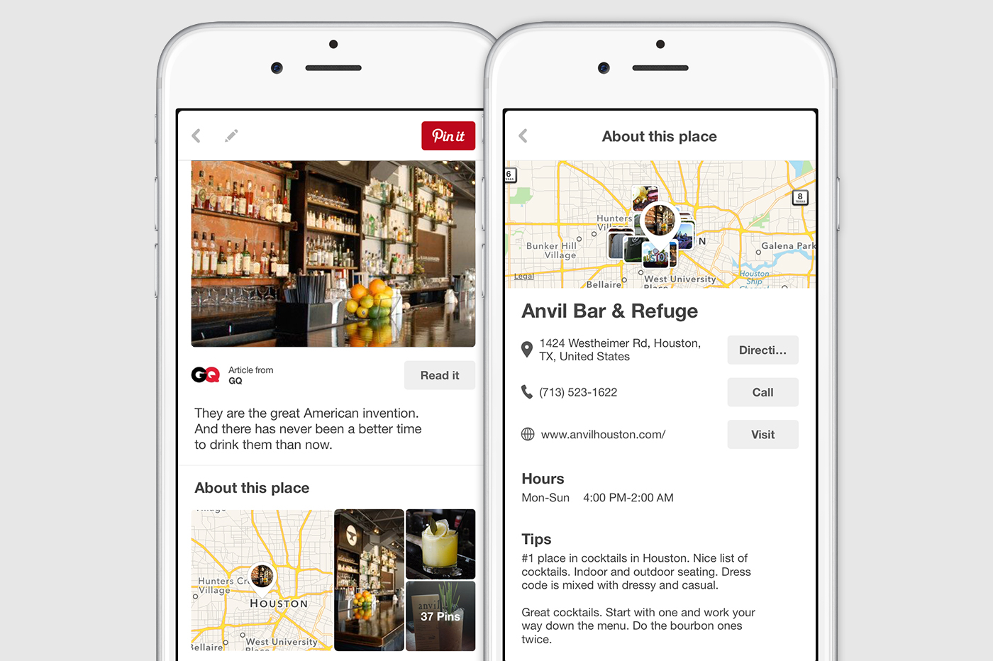
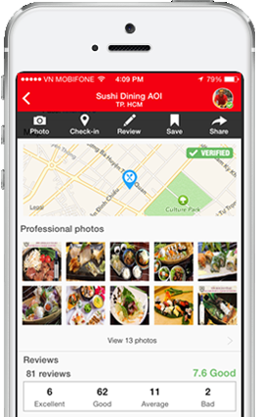

Slide 5
MKMapView: MKMapView is a UI control which is used to display map in iOS devices.
Annotation: Annotations is information related to a particular place on the map. These include grocery stores, gas stations, malls or even custom information inserted by the user.
AnnotationView: The visual appearance of Annotations are defined using the MKAnnotationView class. By default the annotations are displayed using the pin annotation view.

Slide 6
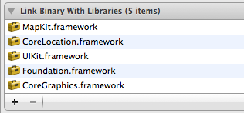
Referencing the Frameworks:
For this application we will be using the MapKit.framework and CoreLocation.framework.

Slide 7
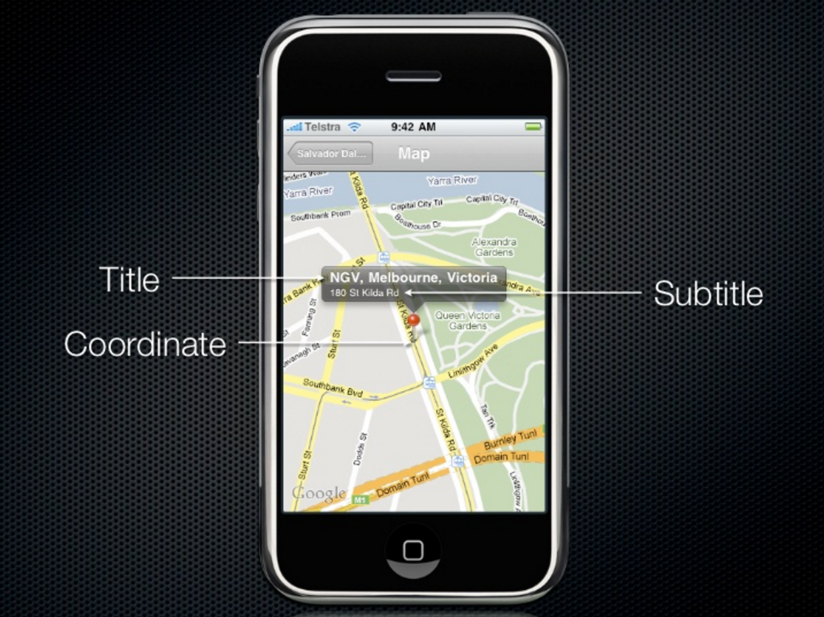
Annotation view

Slide 8
Map kit demo
Using Maps (Swift in Xcode)
iOS Programming: MapKit Directions in MapView Xcode 6.4 and swift

Slide 9
GEOCoding location
A geocoder object uses a network service to convert between latitude and longitude values and a user-friendly placemark, which is a collection of data such as the street, city, state, and country information. Reverse geocoding is the process of converting a latitude and longitude into a placemark; forward geocoding is the process of converting place name information into latitude and longitude values. Reverse geocoding is supported in all versions of iOS, but forward geocoding is supported only in iOS 5.0 and later. Both reverse and forward geocoding are supported in OS X v10.8 and later.
iOS Working With Location Services Tutorial | Geocoding

Slide 10
A ton of sweet things about Map kit and core location
Location and Maps Programming Guide
http://nshipster.com/core-location-in-ios-8/
http://www.raywenderlich.com/90971/introduction-mapkit-swift-tutorial

Slide 11
Google Map SDK
https://developers.google.com/maps/documentation/ios-sdk/

